Slide 1

Date:- 15/11/2021
Project Title | P75- Summary Extraction along with sentiment analysis.
Team Members | Manan Malhotra
 | Nandini Reddy
 | Renu Rawat
 | Rohit Pawar
 | Shubham Patel
Project Guide | Mr. Parth Sagar

Slide 2
Business Problem:
Business Objective : P75- Summary Extraction along with sentiment analysis.
Objective:
To extract E-books of your choice and extract summary, categorize summary as positive, negative or neutral. Build a NLP model to achieve the said objective with accepted accuracy of 75% and above.

Slide 3
Exploratory Data Analysis
Why EDA ?
Exploratory Data Analysis refers to the critical process of performing initial investigations on data so as to discover patterns, to spot anomalies, to test hypothesis and to check assumptions with the help of summary statistics and graphical representations.

Slide 4
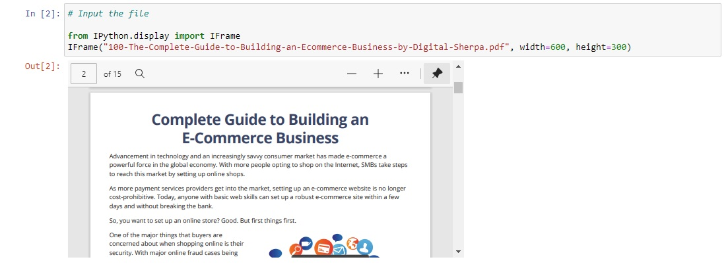
DATA SET

Slide 5
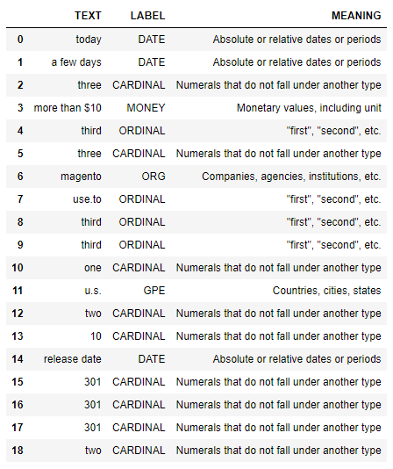
NAMED ENTITY RECOGNITION

Slide 6
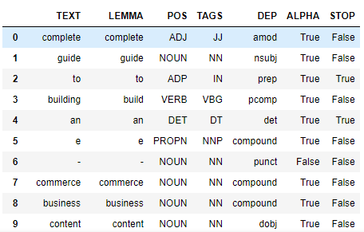
Parts of Speech & Dependency

Slide 7
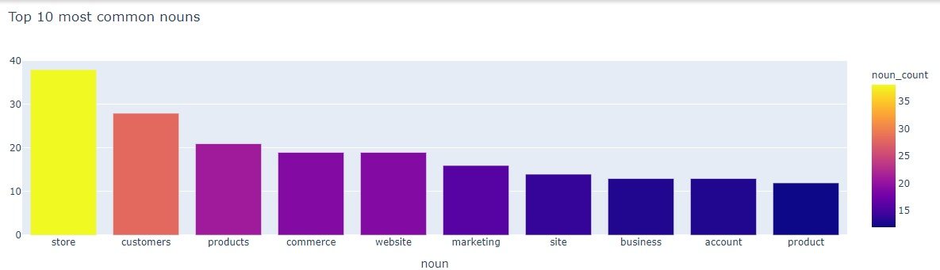
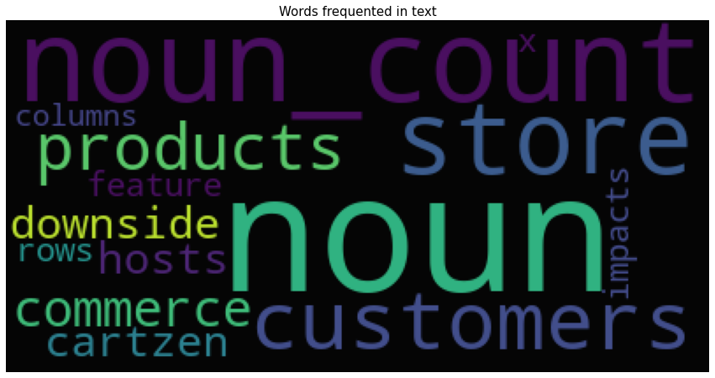
Noun Extraction

Slide 8
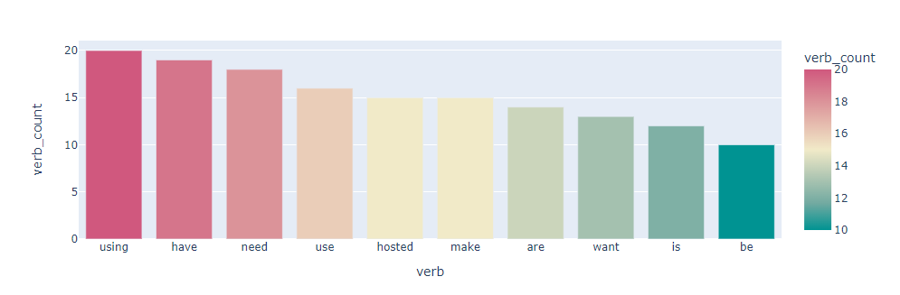
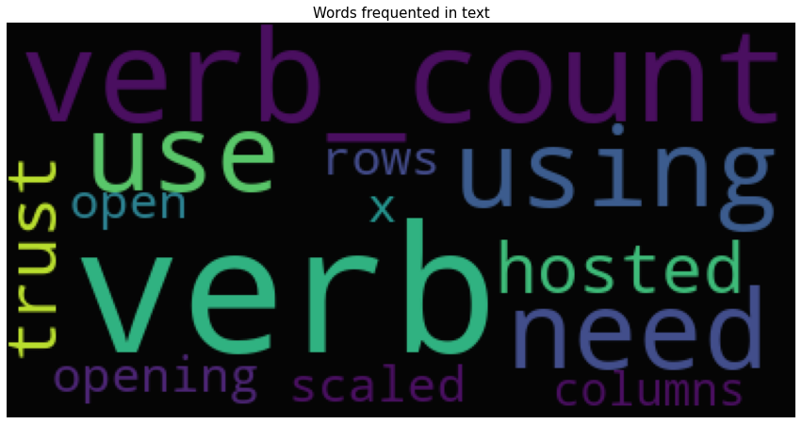
Verb Extraction

Slide 9
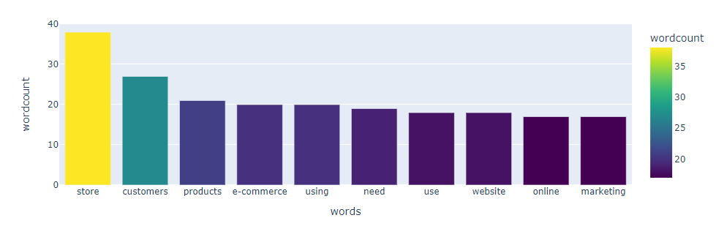
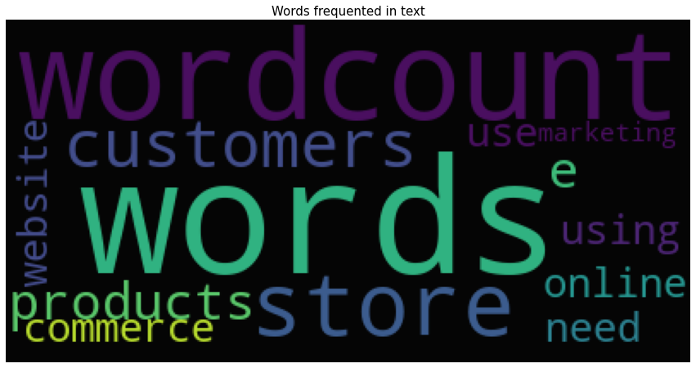
WORD COUNT

Slide 10
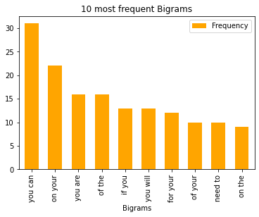
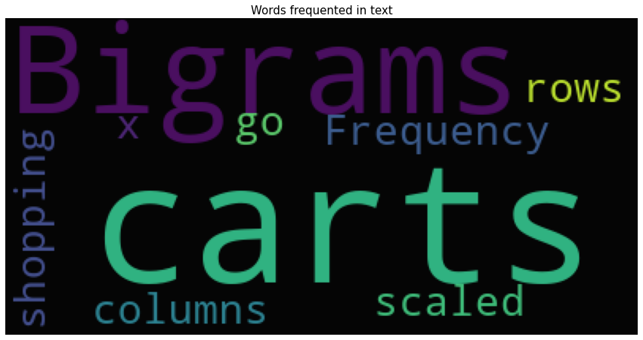
Bigrams

Slide 11
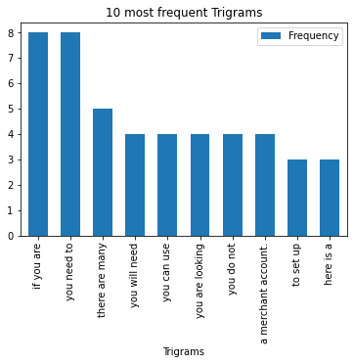
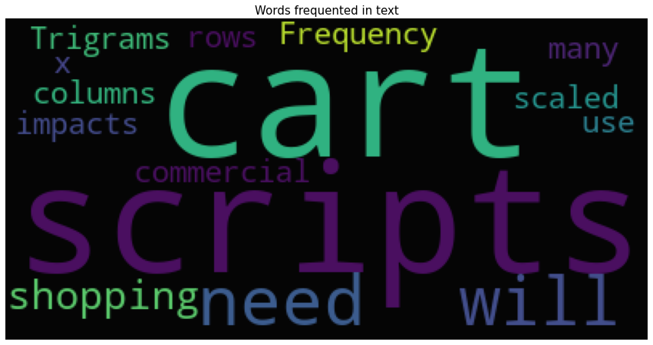
Trigrams

Slide 12

Model Building

Slide 13
Template for Model results presentation
Pre Trained Models
Data set details
Ecommerce_Business_Guide.pdf
Data Partition details
Corpus
Algorithm details and configuration
Sumy summarizers and Gensim summarizer for Extractive
Transformer summarizers for Abstractive
Trained Models
Spacy- Word Frequency
TF-IDF– Math Functions & NLTK
BOW – Count Vectorizer – Sklearn
TF IDF Vectorizer – Sklearn

Slide 14
Model Results
Model generated the output for ebook that was summarized within 5 sentences using different pre-defined summarizers which were abstractive and extractive. Modules that were imported were sumy and transformer.
After that we trained our models using Spacy-word frequency, TF-IDF– Math Functions & NLTK, BOW– Count Vectorizer and TF-IDF Vectorizer and were able to generate the summary from our E-book.
Sentiment Analysis was done on the summaries generated by each model.

Slide 15
Types of Pre Trained Summarizers Used
LexRank Summarizer
Luhn Summarizer
LSA Summarizer
TextRank Summarizer
Edmundson Summarizer
Reduction Summarizer
Gensim Summarizer
T5 Summarizer

Slide 16
Types of Trained Models for Summarization Used
Spacy- word frequency
TF-IDF – Math Functions & NLTK
BOW – Count Vectorizer – Sklearn
TF-IDF Vectorizer – Sklearn

Slide 17
Extractive Summarization - TF-IDF
TF-IDF (term frequency-inverse document frequency) is a statistical measure that evaluates how relevant a word is to a document in a collection of documents.
It is done by multiplying two metrics: how many times a word appears in a document, and the inverse document frequency of the word across a set of documents.
It has many uses, most importantly in automated text analysis, and is very useful for scoring words in machine learning algorithms for Natural Language Processing (NLP).

Slide 18
Extractive Summarization – Using Spacy - word frequency
Input Text
Text Cleaning & Preprocessing
Word Tokenization
Sentence Scanning
Word Frequency Table
Generate Summary
Summary

Slide 19
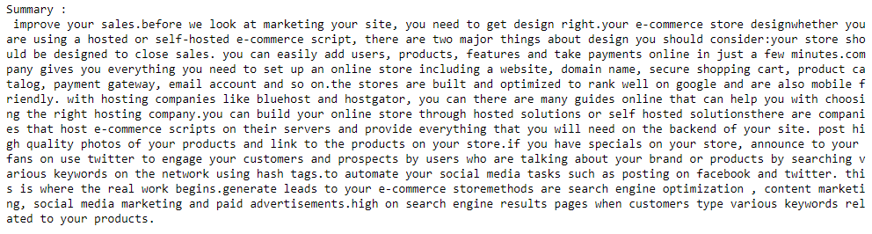
Summary Generated

Slide 20
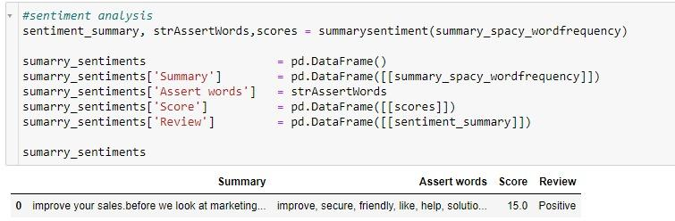
Sentiment Analysis

Slide 21
TF-IDF Math Functions and NLTK
Input Corpus
Tokenize Sentence
Create Frequency Matrix of word in each sentence
Sentence Score =
Sum of TF-IDF score of all words in sentence / Total number of words in sentence
Create TF-IDF Score Of Words in each sentence
Calculate Threshold = Average of sentence score
Generate Summary select sentence score > Threshold
Summary

Slide 22
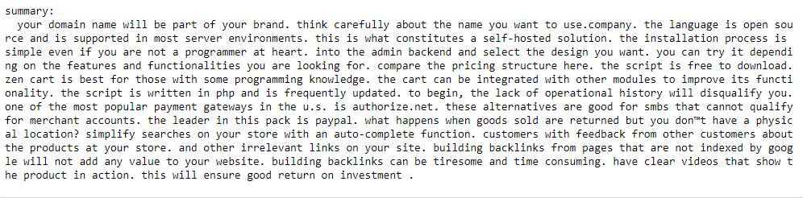
Summary Generated

Slide 23
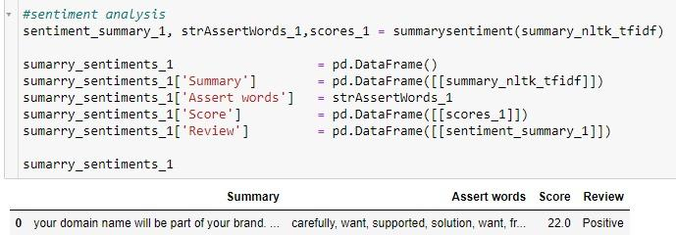
Sentiment Analysis

Slide 24
BOW Count Vectorizer - Sklearn
Input Corpus
Tokenize Sentence
Count Vectorizer
Select Top 5 Sentence Score
Sum BOW Scores
Summary

Slide 25
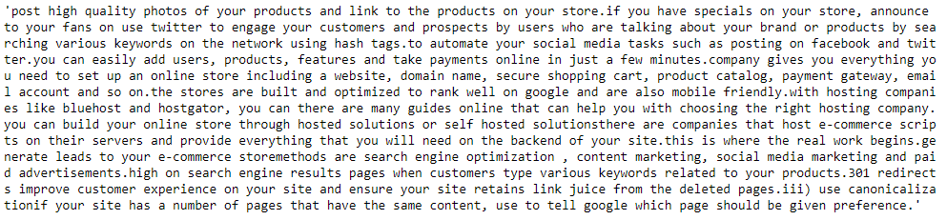
Summary Generated

Slide 26
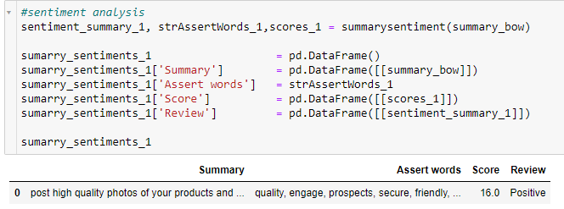
Sentiment Analysis

Slide 27
TF-IDF Vectorizer - Sklearn
Input Corpus
Tokenize Sentence
TF-IDF Vectorizer
Select Top 5 Sentence Score
Sum TF-IDF Scores
Summary

Slide 28
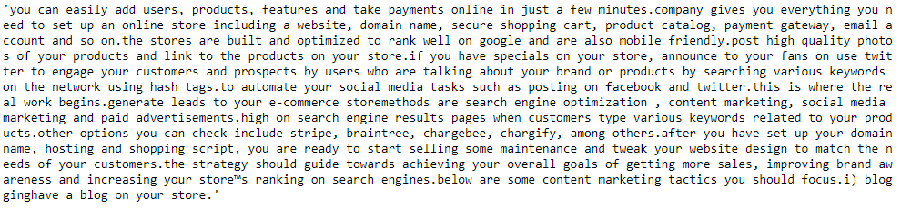
Summary Generated

Slide 29
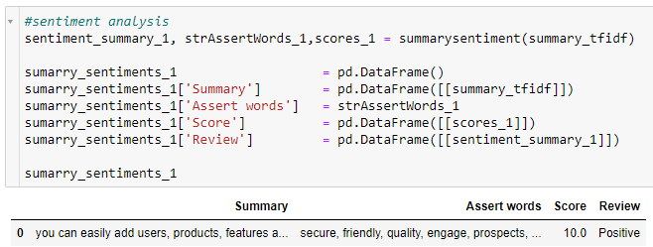
Sentiment Analysis

Slide 30
Model Evaluation – Using Rouge Score
Model Summery | Reference Summery (automatic summarization) | Rang 1 {RP F(%)} | Rang 2 {PLP F(%)} | Rang L {PRP F(%)}
Word Frequency-Spacy. | Reduction Summarizer Edmondson Summarizer | 100/100/99 88/88/88 | 98/98/98 80/85/83 | 100/100/99 87/87/87
BOW – Contrectorizer / Sklearn | Reduction Summarizer Edmondson Summarizer | 89/87/88 77/76/77 | 82/83/83 66/70/68 | 89/87/88 77/75/76
TF-IDF Vectorizer –Sklearn | Reduction Summarizer Edmondson Summarizer | 73/74/74 61/62/62 | 62/68/65 47/54/50 | 73/74/74 61/62/61

Slide 31
Model Deployment using R Shiny / Flask or any other method

Slide 32
Feedback
Challenges faced?
How did you overcome?

Slide 33
Thank you

